Slide 1



AWS S3 Lifecycle Rules: Optimizing Storage and Costs
AWS S3 Lifecycle Rules allow you to manage your objects so that they are stored cost-effectively throughout their lifecycle. By defining lifecycle rules, you can transition objects to different storage classes or delete them after a certain period. These rules can help you save money on your S3 bill by automatically moving data to cheaper storage classes or deleting data that is no longer needed.
by Ram N Java

Slide 2

What Are S3 Lifecycle Rules?
Definition
Transition Actions
Expiration Actions
Lifecycle rules in S3 allow you to define actions on your objects based on their age or other criteria.
Move objects to a different storage class.
Permanently delete objects after a certain period.

Slide 3
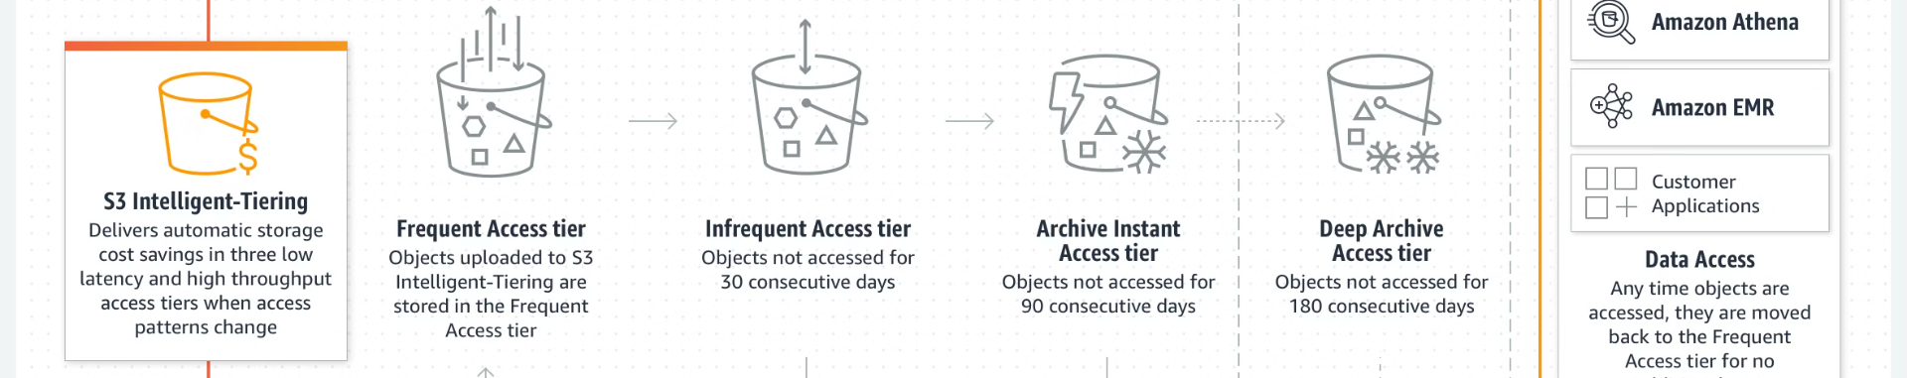
S3 Storage Classes Overview
1
S3 Standard
2
S3 Intelligent-Tiering
3
S3 Standard-IA (Infrequent Access)
General-purpose storage for frequently accessed data.
Automatically moves data to the most
cost-effective access tier.
For data that is accessed less frequently, but requires rapid access when needed. Lower cost for data accessed less frequently.

Slide 4

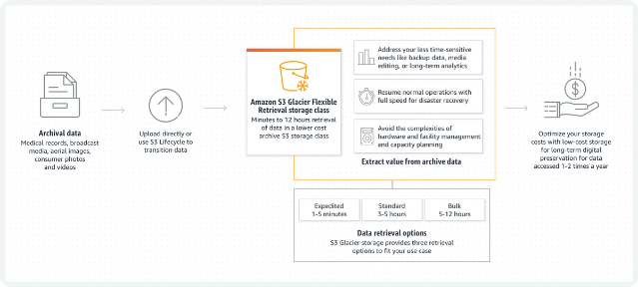
More S3 Storage Classes
1
S3 One Zone-IA
Lower cost option for infrequently accessed data stored in a single availability zone.
2
S3 Glacier
Low-cost storage for data archiving; retrieval times range from minutes to hours.
3
S3 Glacier Deep Archive
Lowest-cost storage for long-term data archiving; retrieval times range from 12 to 48 hours.

Slide 5

Setting Up Lifecycle Rules: Overview
You can set up Lifecycle Rules through the AWS Management Console, AWS CLI, or using AWS SDKs. Here's an overview of how to do it via the AWS Management Console:
1
Step 1: Navigate to S3 Console
Log in to the AWS Management Console and navigate to the S3 service.
2
Step 2: Select a Bucket
Choose the bucket where you want to apply the lifecycle rules.
3
Step 3: Open Management Tab
Click on the Management tab and then click Create lifecycle rule.

Slide 6

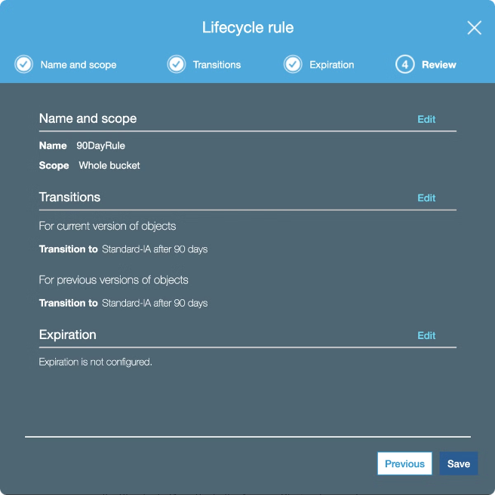
Setting Up Lifecycle Rules: Configuration
1
Step 4: Define Rule Scope
Enter a rule name and define the scope of the rule by specifying the prefix or tags to filter objects.
2
Step 5: Configure Transition Actions
Add a transition action based on object age. Example: Move objects to S3 Standard-IA after 30 days, and to S3 Glacier after 90 days.
3
Step 6: Configure Expiration Actions
Add an expiration action to delete objects after a certain period. Example: Permanently delete objects after 365 days.

Slide 7


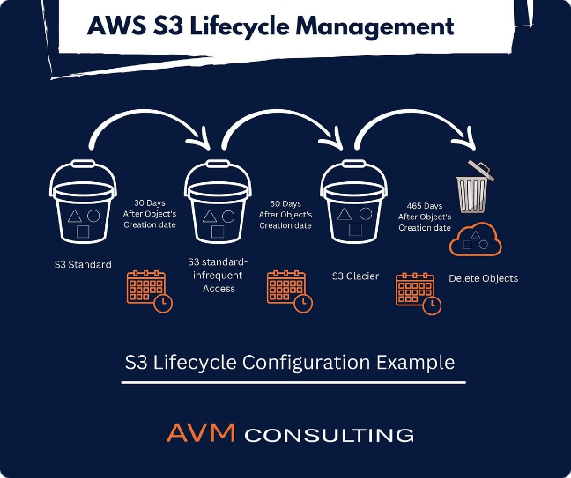


Finalizing Lifecycle Rule Setup
Review Configurations
Carefully review all the configurations you've set for the lifecycle rule.
Save the Rule
Click the "Create rule" button to save and activate the lifecycle rule.
Monitor and Adjust
Regularly monitor the rule's effectiveness and adjust as needed.

Slide 8
Example Use Case: Scenario
Data Access Pattern
Optimal Storage Solution
You have a bucket where data is frequently accessed for the first 30 days, infrequently accessed for the next 60 days, and rarely accessed afterward.
Set up a lifecycle rule with transitions to match this access pattern, moving data through different storage classes as it ages.

Slide 9

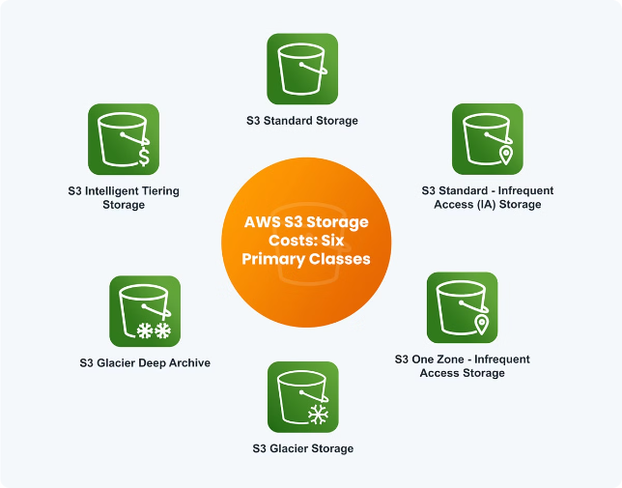
Example Use Case: Solution
1
Day 0-30
Store data in S3 Standard for frequent access.
2
Day 31-90
Transition data to S3 Standard-IA for infrequent access.
3
Day 91 onwards
Transition data to S3 Glacier for long-term archival.

Slide 10

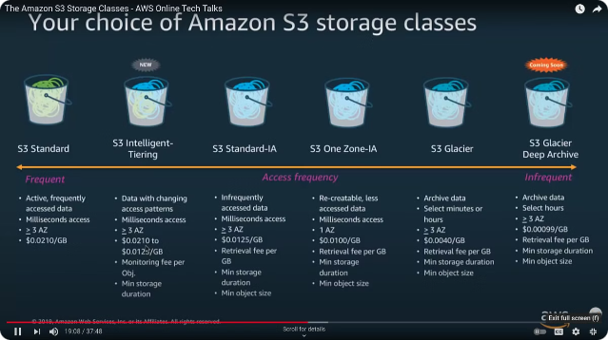
Example Use Case: Implementation
Create Lifecycle Rule
Set up a new lifecycle rule in your S3 bucket.
Day 30 Transition
Configure a transition to S3 Standard-IA after 30 days.
Day 90 Transition
Add another transition to S3 Glacier after 90 days.

Slide 11



Benefits of Using Lifecycle Rules: Cost Savings
Cost Savings
Optimization
Automatically transition data to cheaper storage classes as it ages, reducing overall storage costs.
Helps optimize storage usage by automatically deleting objects that are no longer needed.

Slide 12




Benefits of Using Lifecycle Rules: Management and Compliance
Data Management
Simplify data management by automating transitions
and deletions.
Compliance
Ensure data is retained for a required period and then deleted automatically, aiding in regulatory compliance.

Slide 13


Saving Money with Lifecycle Rules: Storage Class Strategy
Data Type
Recommended Storage Class
Frequently Accessed Data
S3 Standard
Infrequently Accessed Data
S3 Standard-IA or
S3 One Zone-IA
Archive Data
S3 Glacier or
S3 Glacier Deep Archive
Old Data
Automatically delete after it is no longer needed

Slide 14

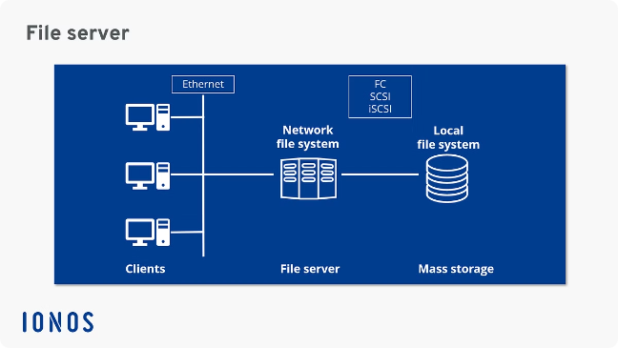
Saving Money:
Frequently Accessed Data
S3 Standard
Keep frequently accessed data in S3 Standard for immediate availability and high throughput.
Cost Consideration
While more expensive per GB, it's cost-effective for data that's accessed multiple times per month.
Use Case
Ideal for active websites, mobile and gaming applications, and big data analytics.

Slide 15
Saving Money: Infrequently Accessed Data
S3 Standard-IA
S3 One Zone-IA
Move infrequently accessed data to
S3 Standard-IA for lower storage costs while maintaining rapid access when needed.
For even lower costs, use S3 One Zone-IA if your data can be recreated or is replicated elsewhere.

Slide 16
Saving Money: Archive Data
S3 Glacier
S3 Glacier Deep Archive
Move archive data to S3 Glacier for
long-term storage at significantly lower costs. Retrieval times range from minutes to hours.
For the lowest storage costs, use
S3 Glacier Deep Archive for data that is rarely accessed and can tolerate retrieval times of 12 to 48 hours.

Slide 17

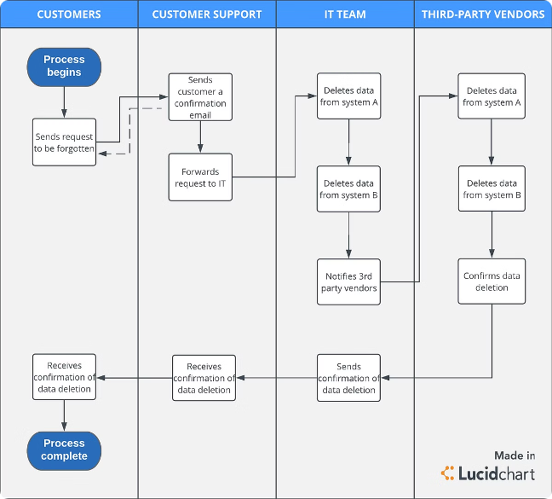
Saving Money:
Old Data Management
Identify Old Data
Use lifecycle rules to identify data that has reached the end of its useful life.
Set Expiration
Configure expiration actions to automatically delete old data after a specified period.
Reduce Costs
By deleting unnecessary data, you reduce storage costs and simplify data management.

Slide 18

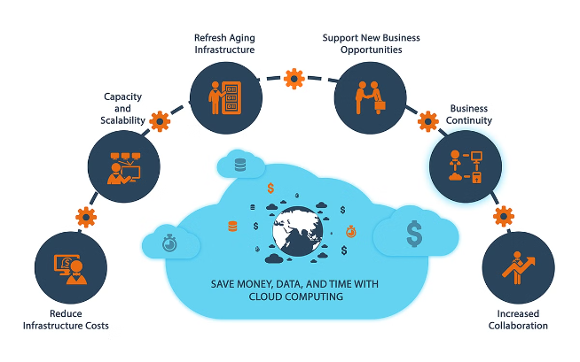
Conclusion:
Leveraging S3 Lifecycle Rules
Optimize Storage Costs
By leveraging S3 Lifecycle Rules, you can optimize your storage costs and ensure efficient data management in
AWS S3.
Automate Data Management
Lifecycle rules automate the process of moving data between storage classes and deleting unnecessary data.
Improve Efficiency
With proper implementation, you can significantly reduce your S3 storage costs while maintaining optimal data access and compliance.

